Slide 1
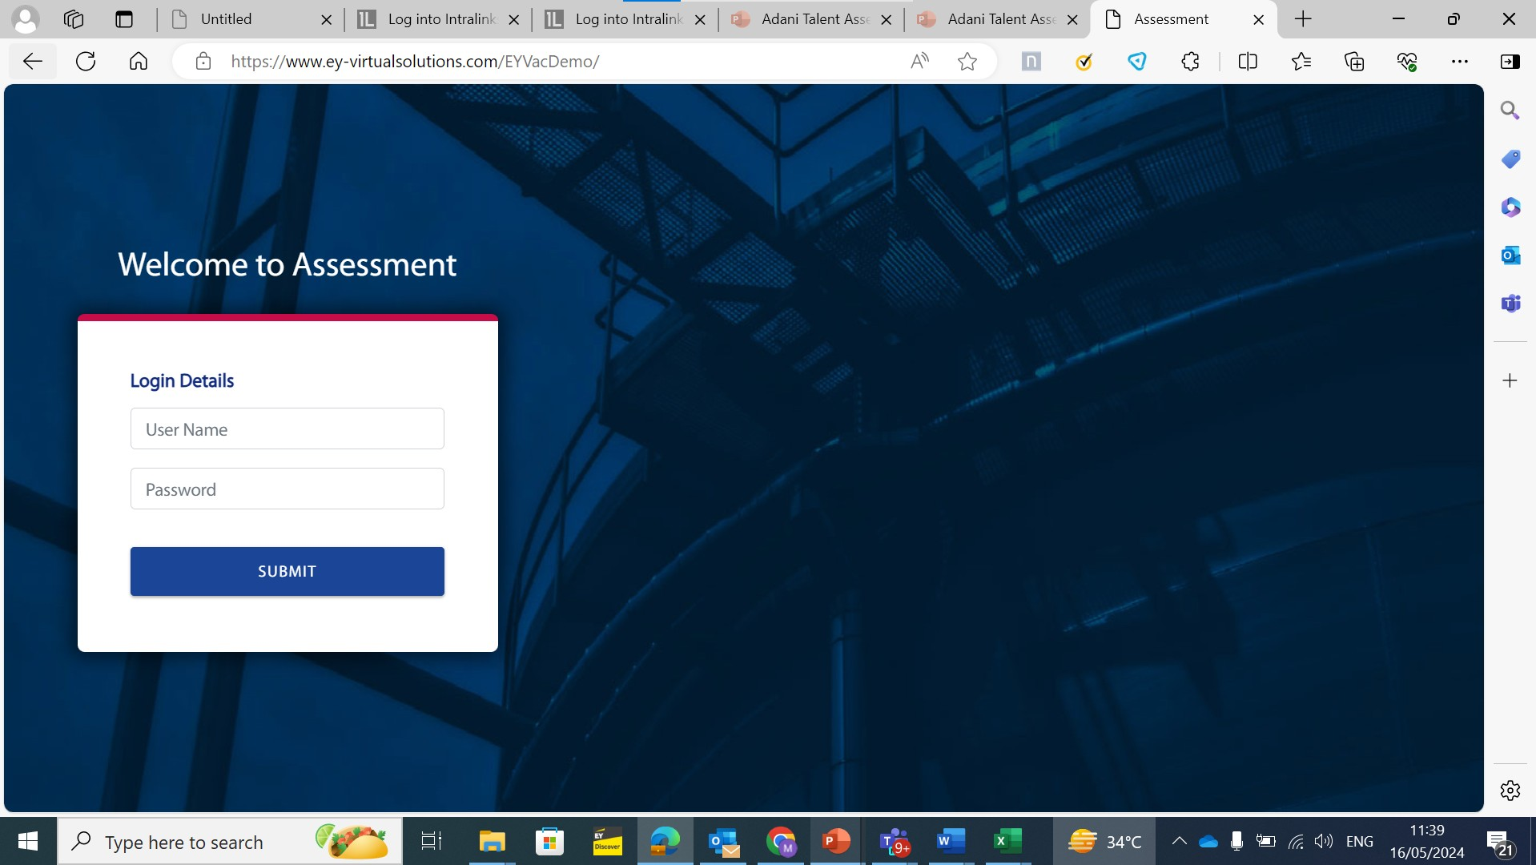

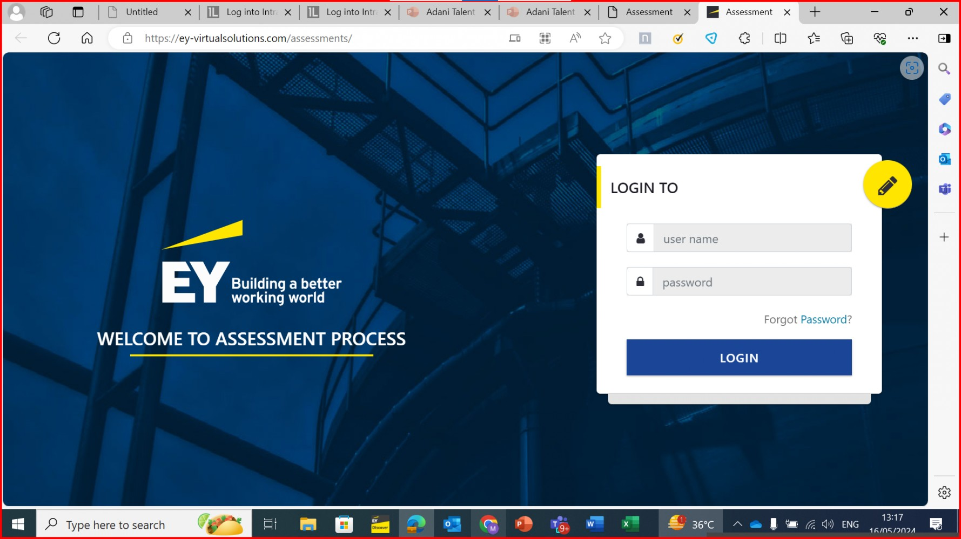
Add the terms and conditions with a tick box above submit button
Page should look like pic no. 2
pic no. 2
Change “welcome to assessment process” to “CRAFTING YOUR PERSONAL JOURNEY”

Slide 2
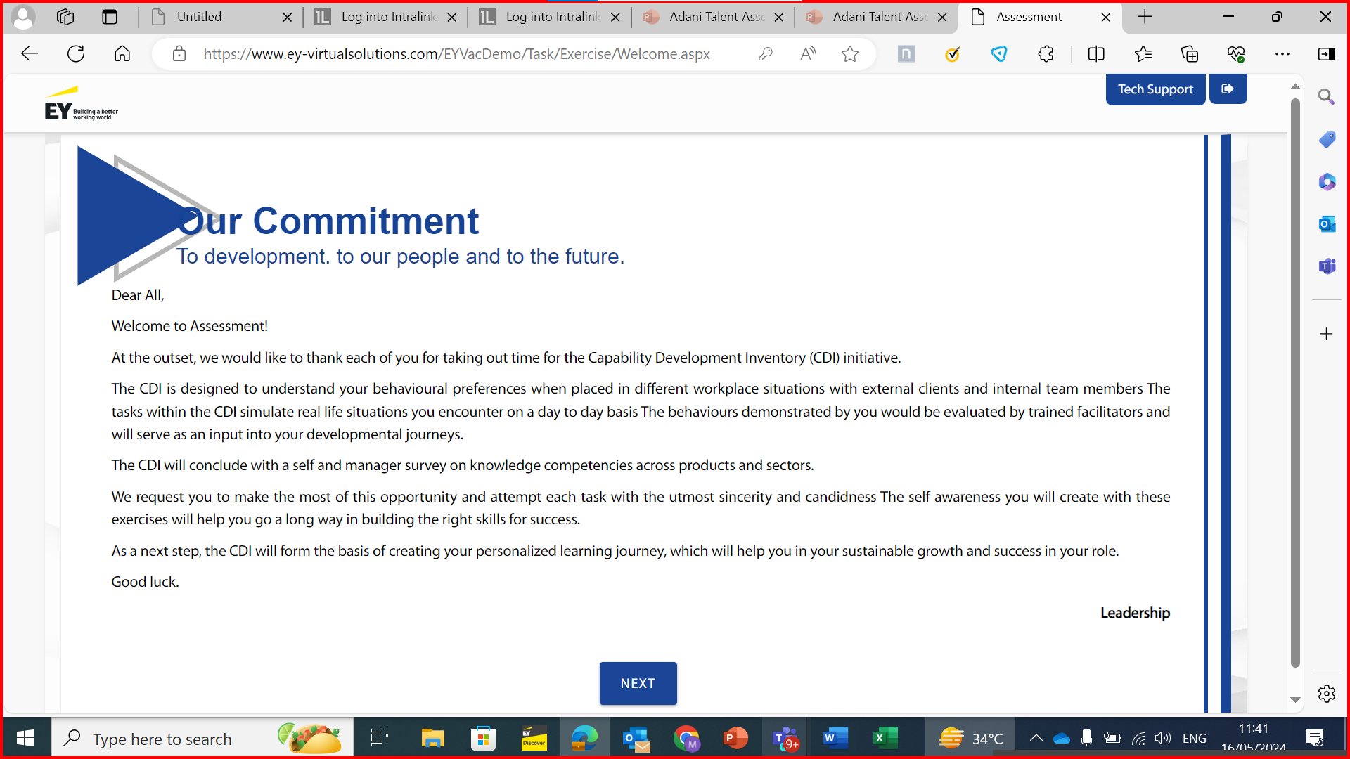
Put the text part on left side (60% of page) and put a video place holder on the right side of page
Text to be replaced with –
MESSAGE FROM THE LEADERSHIP TEAM
Dear Colleague,
At the outset, we would like to thank each of you for taking out time to participate in crafting your individual development journey!
This experience is an opportunity for you to reflect and take charge of your individual unique careers and gain insight on strengths and opportunity areas. The tasks you will encounter are designed to mirror real-life situations and provide you with an opportunity to experience and navigate change. The outcome of this exercise is intended to support you in your unique personal journey.
We request you to make the most of this opportunity and attempt each task with the utmost sincerity and candidness.
Wish you the very best.
Cheers!
Leadership Team.
Add a button on top right corner, on left side of Tech Support
Button Name – Site Navigation
Button should have link for a ppt. PPT will be shared shortly

Slide 3
To include proctoring - capture of photo

Slide 4
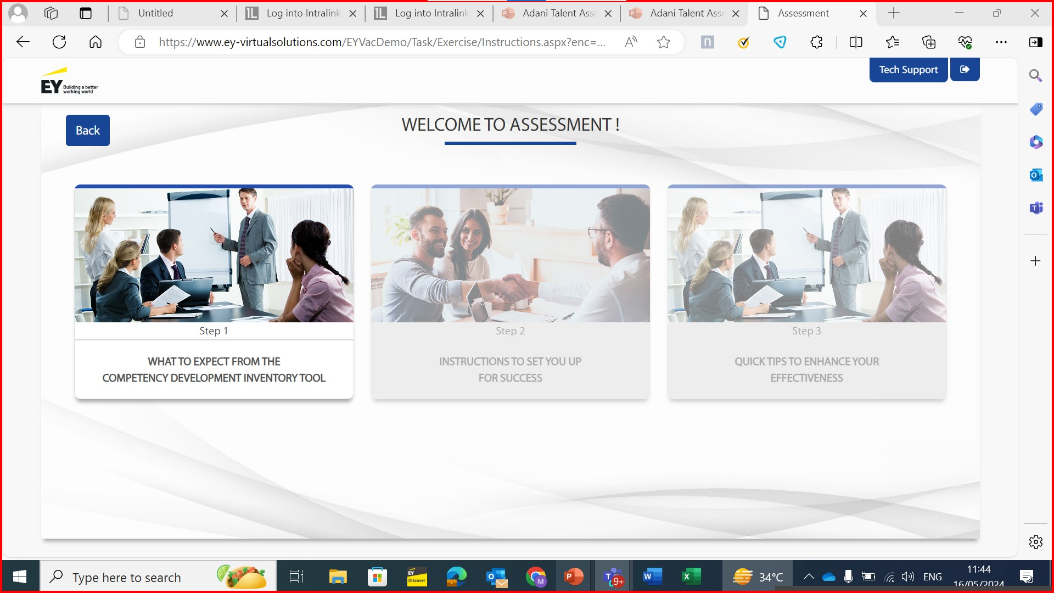
EY logo to be changed – as per picture in slide 17
Replace above text with “INSTRUCTIONS”
Remove “tool’

Slide 5
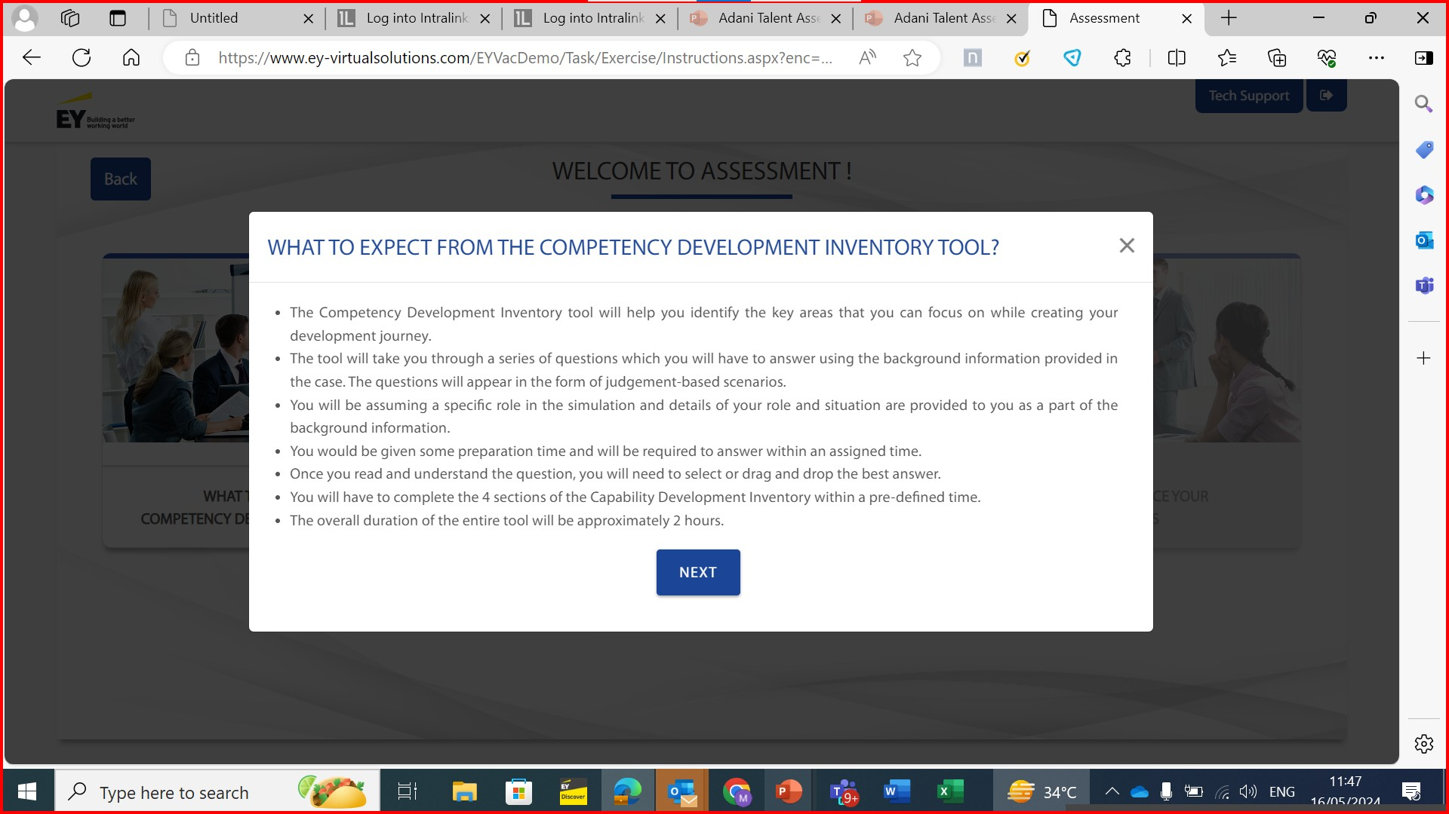
Remove “tool and ?”
Replace Competency Development Inventory Tool with “competency development inventory”
remove “key”
Remove instruction lines 2-7 and replace with below text -
You will go through a set of scenarios that you will need to respond to. The background information tab (if present) will provide you with relevant information that will help you navigate the scenarios effectively
The individual scenarios may have a separate preparation time and separate response time which will reflect in the relevant sections.
You will need to complete all assessments within the indicated timelines.
If you get logged out of the system at any point during the assessment, you can log back in and start from the point where you had left off.
If you need any support during the assessment, you can reach out to the email ID mentioned in the tech support icon visible in the top right corner of the screen.

Slide 6
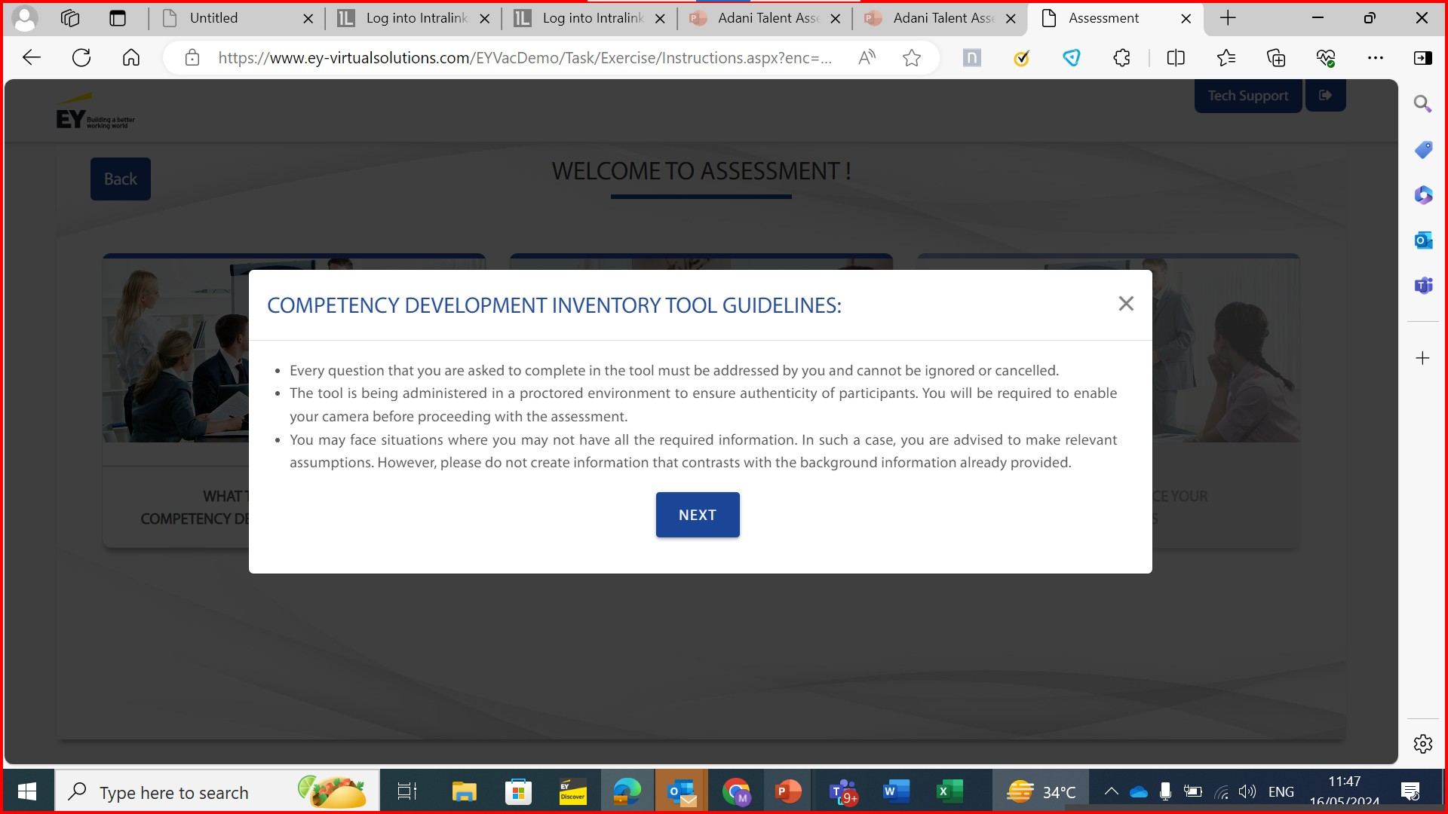
Remove “tool”
Remove instruction lines 1 -2 and replace with below text -
You will be asked to take varied simulations which may involve working by yourself, working in teams or working in other interactive environments.

Slide 7
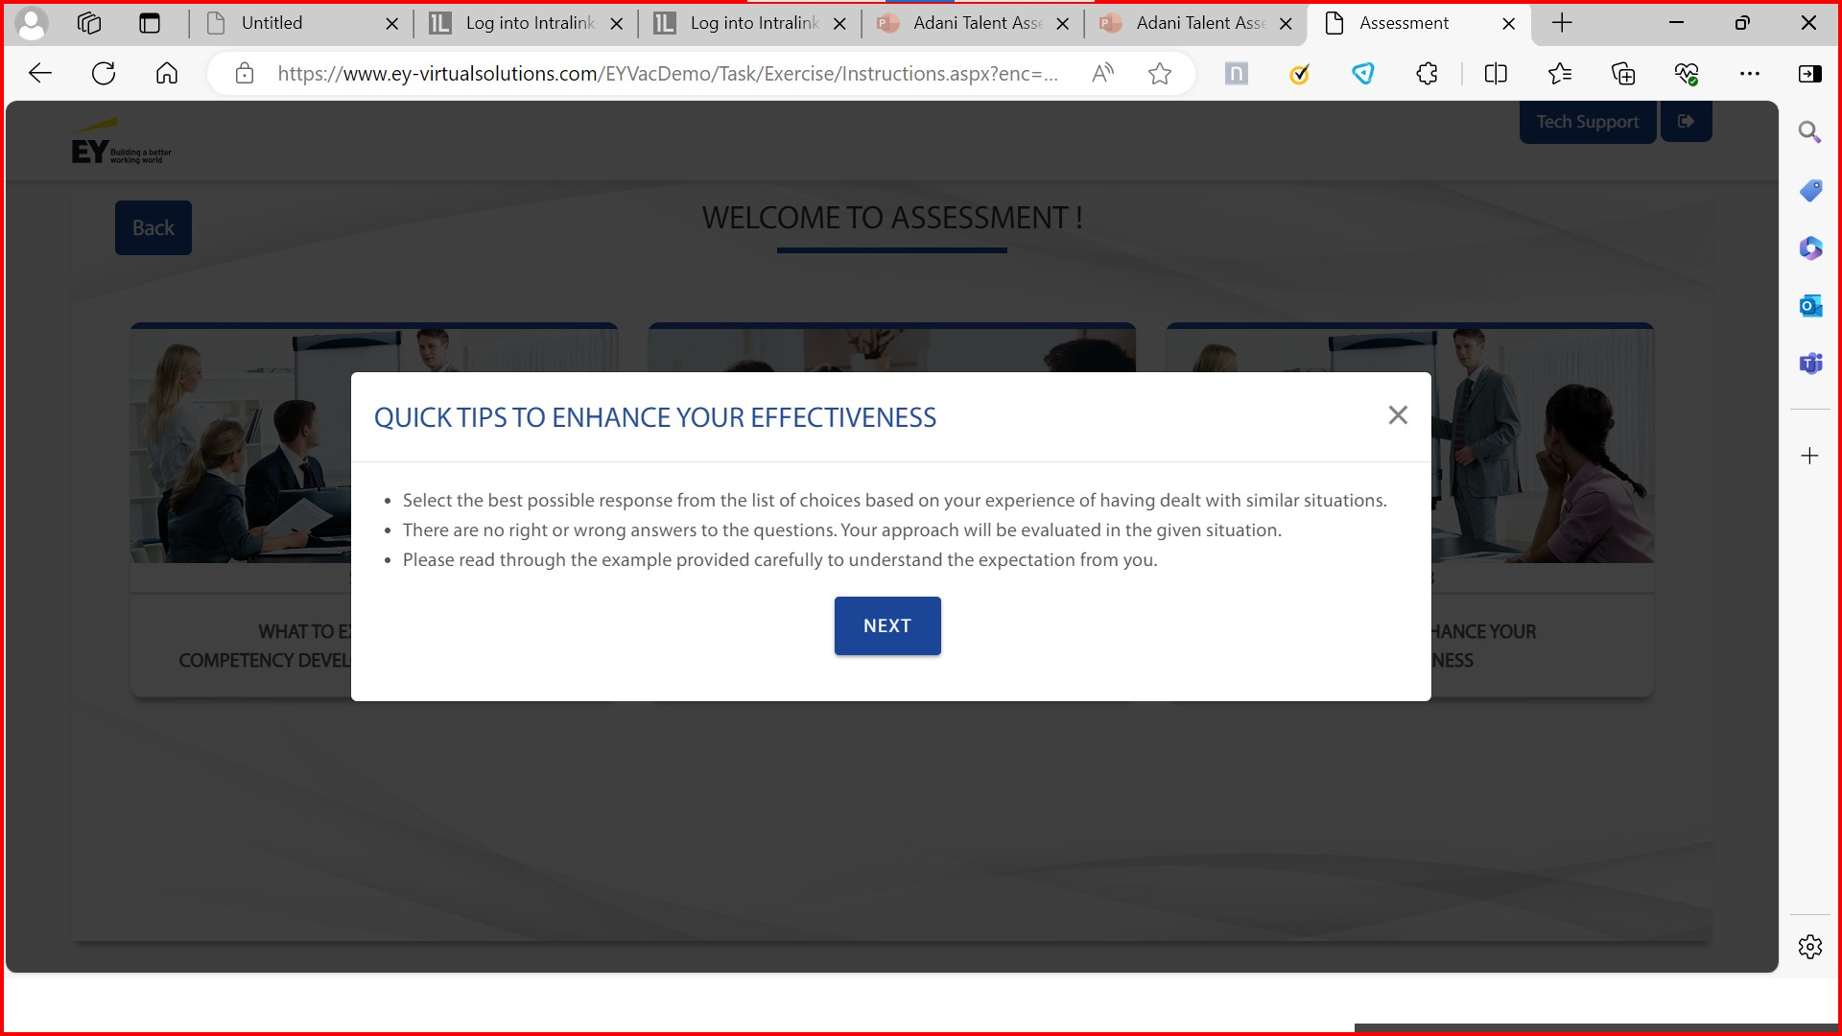
Remove instruction lines 1 -3 and replace with below text -
You are required to consider all given information while responding to the simulations.
Do not overthink your responses and keep it realistic to reflect how you would operate in similar work environments.
There may or may not be a right or wrong answer to the given situations and therefore feel free to leverage your personal experiences while responding to the simulations.

Slide 8
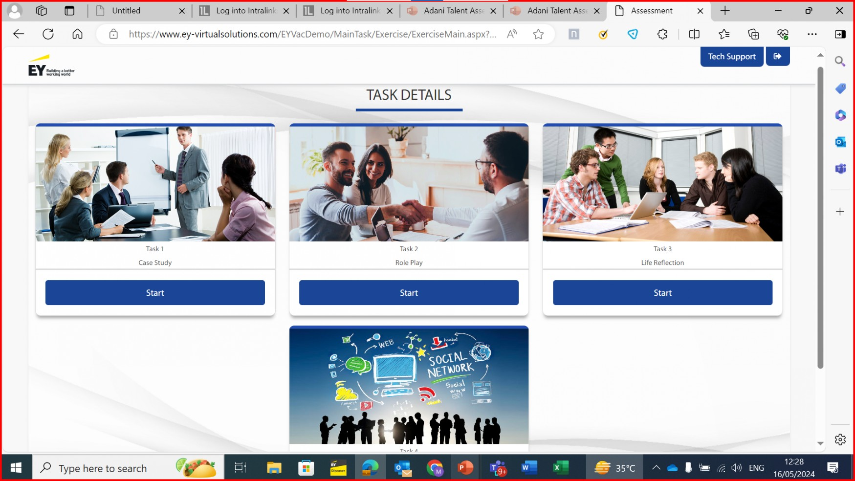
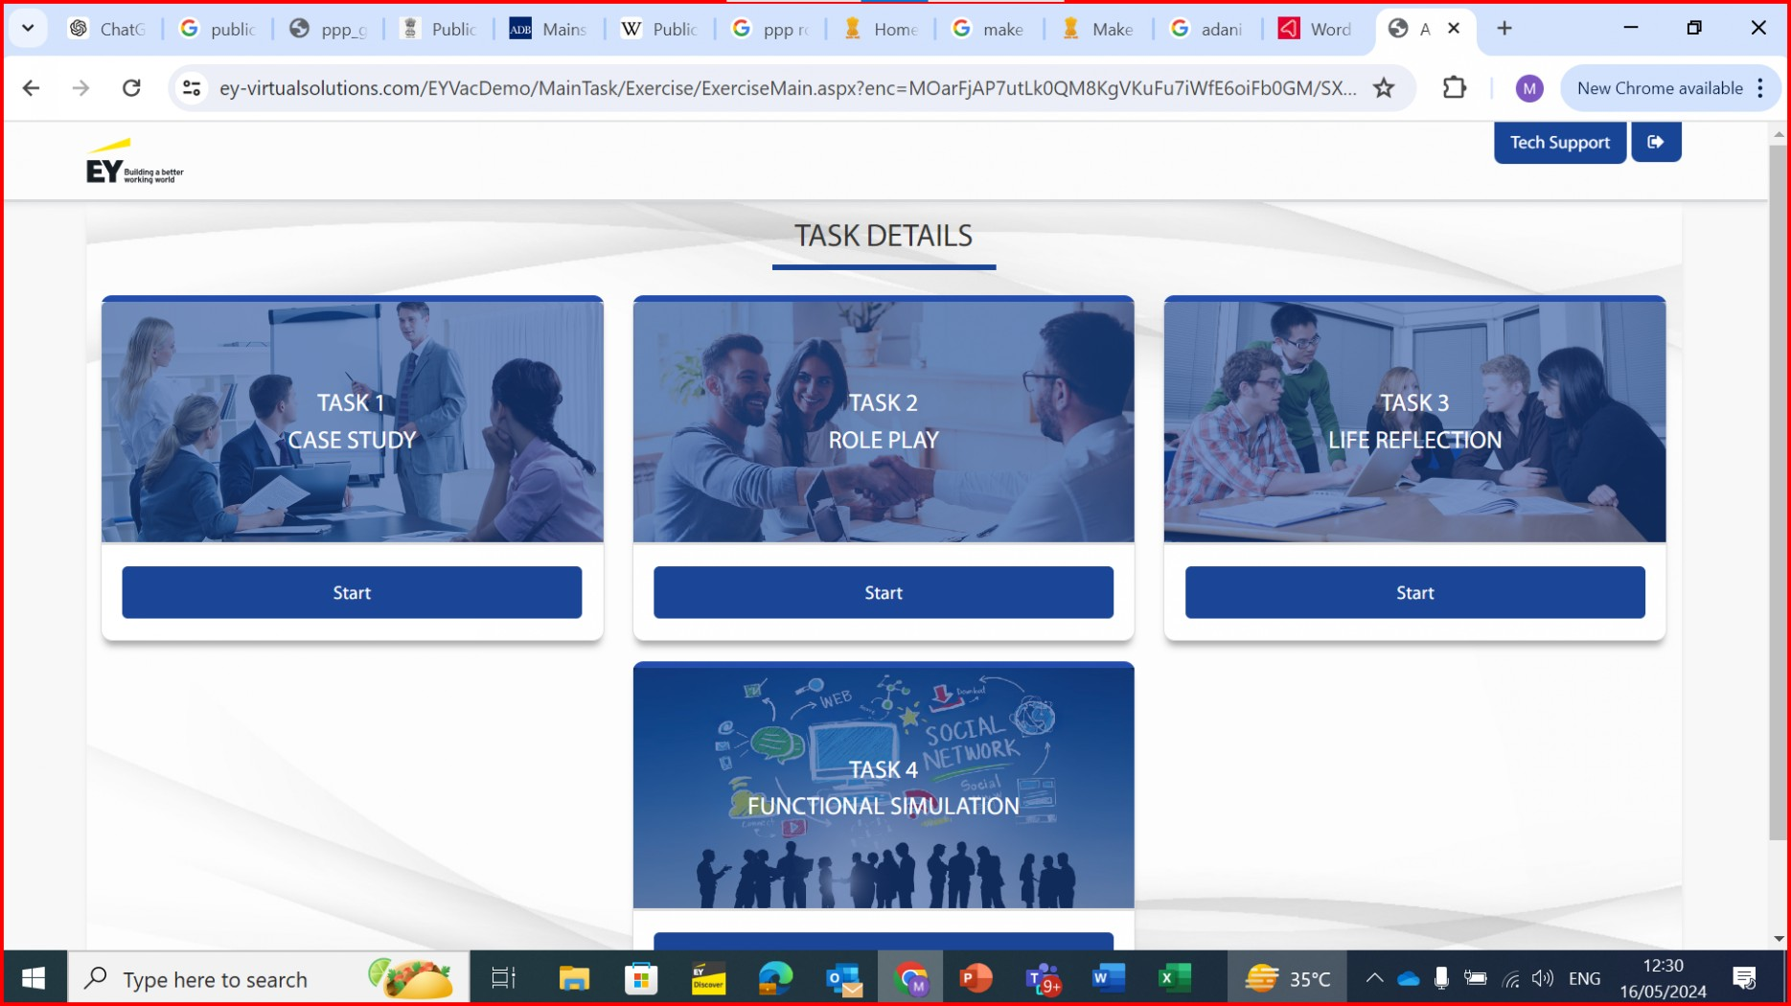
Look of screen in Edge is different than in Chrome – Chrome look is the one we want with orange line on top
EDGE
CHROME
Add one more Task – Total 5 Tasks
Task 1 – Case Study – Pic is ok
Task 2 – Role Play – Pic is ok
Task 3 – Life Reflection – Use current pic for Task 5
Task 4 – Competency Based Interview – New pic 1
Task 5 – Functional Simulation – New pic 2
Name of the tool (CASE STUDY , ROLE PLAY, etc) should be in Bold

Slide 9
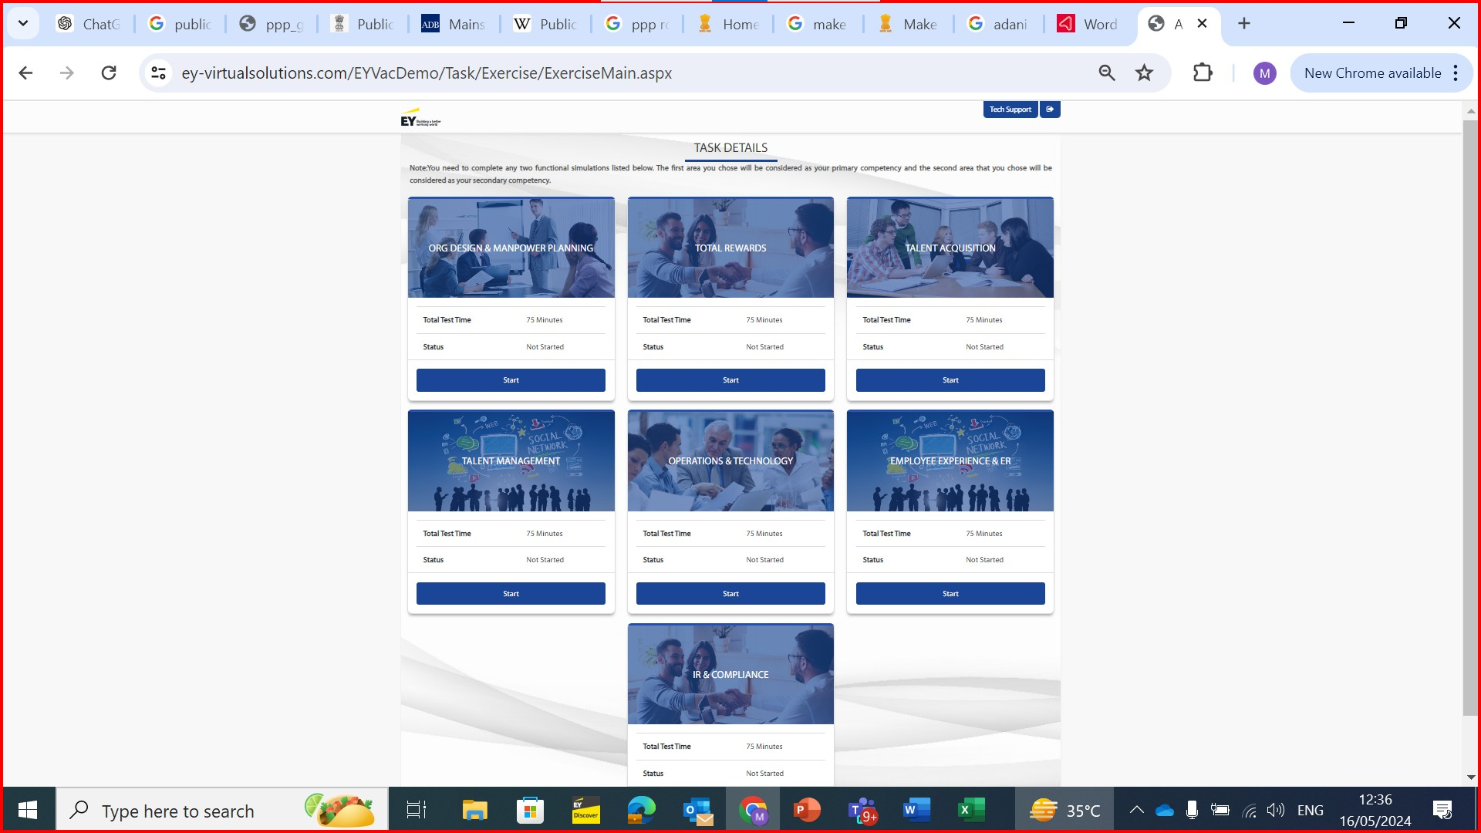
Make the boxes slightly smaller to fit into 2 rows only, so that all 7 boxes can be seen without scrolling down
orange line on top of the boxes instead of blue

Slide 10
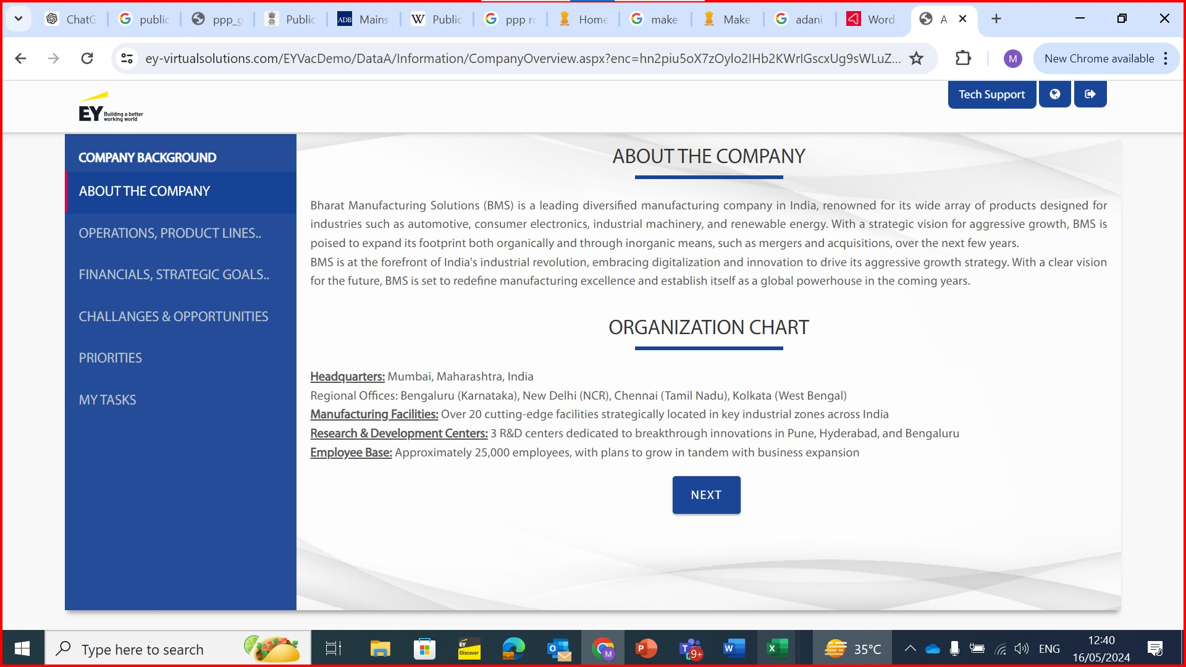
Sections to be redone as below -
About the Company
Market Presence
Growth Plans
Organizational Priorities
Your Role and Current Context
Your Tasks
Revised content for each of the new sections will be shared in attached word doc
Images to be added to the left for each tab as shown in slide 11 for sample – pics are given in slide 19
Remove Language icon on top right

Slide 11
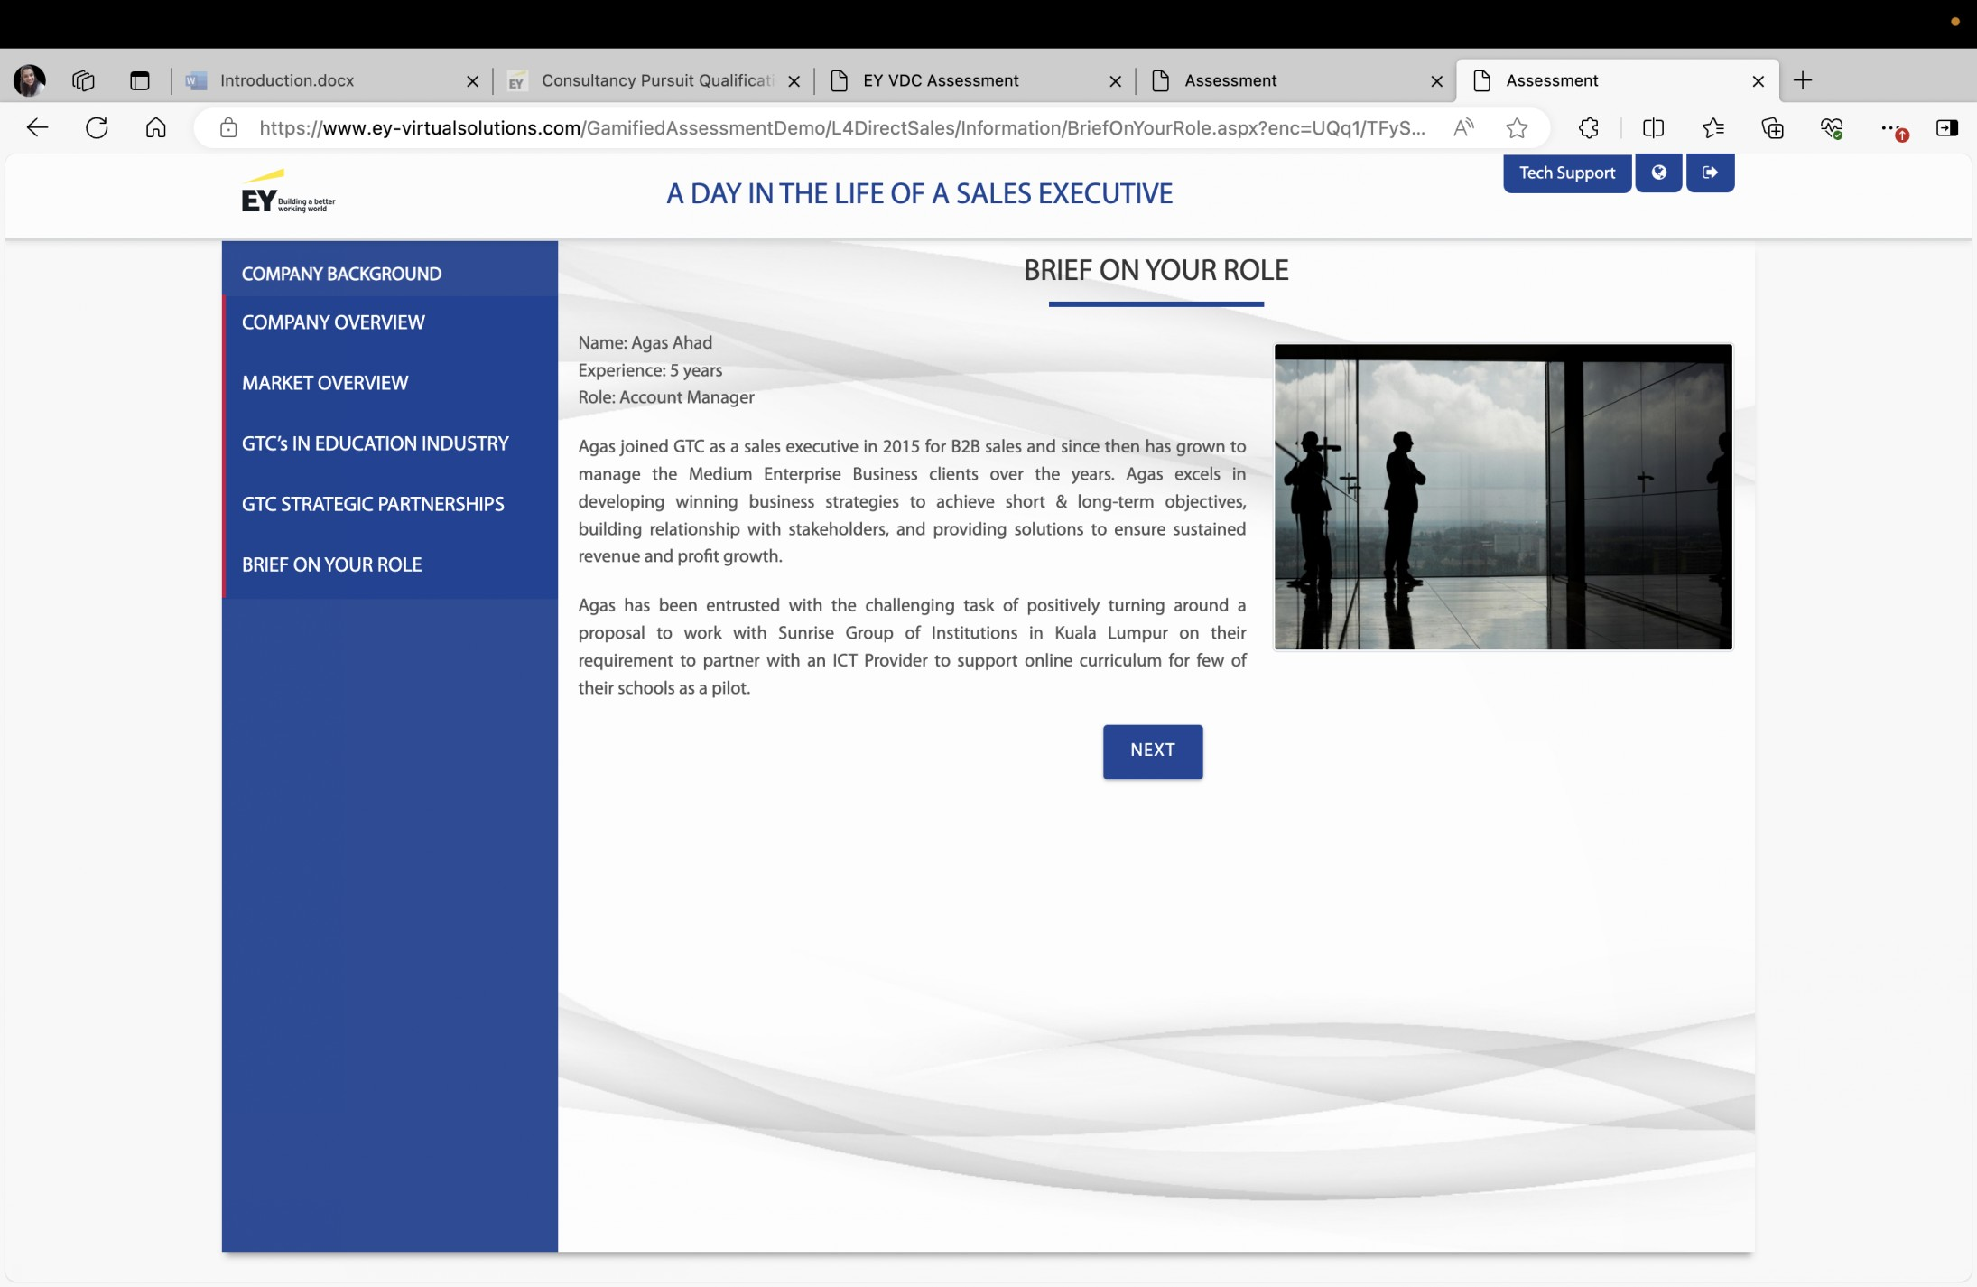
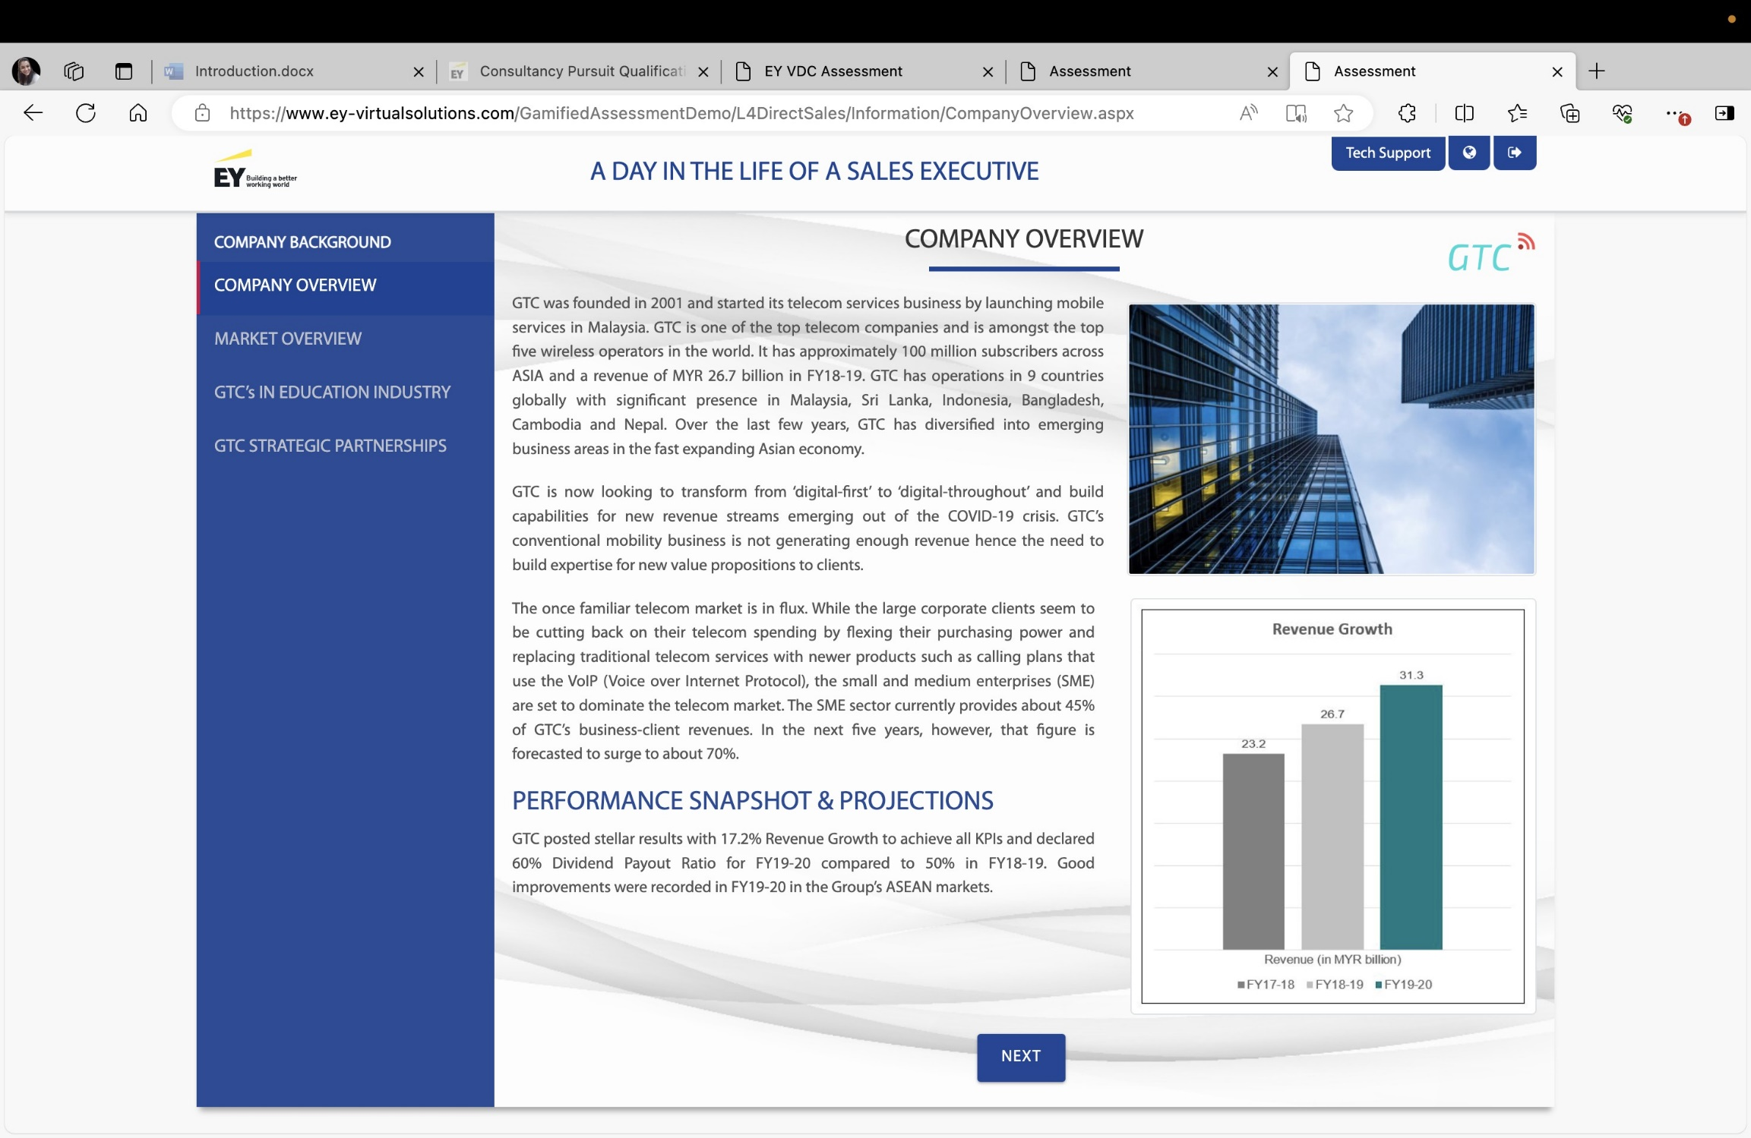

Slide 12
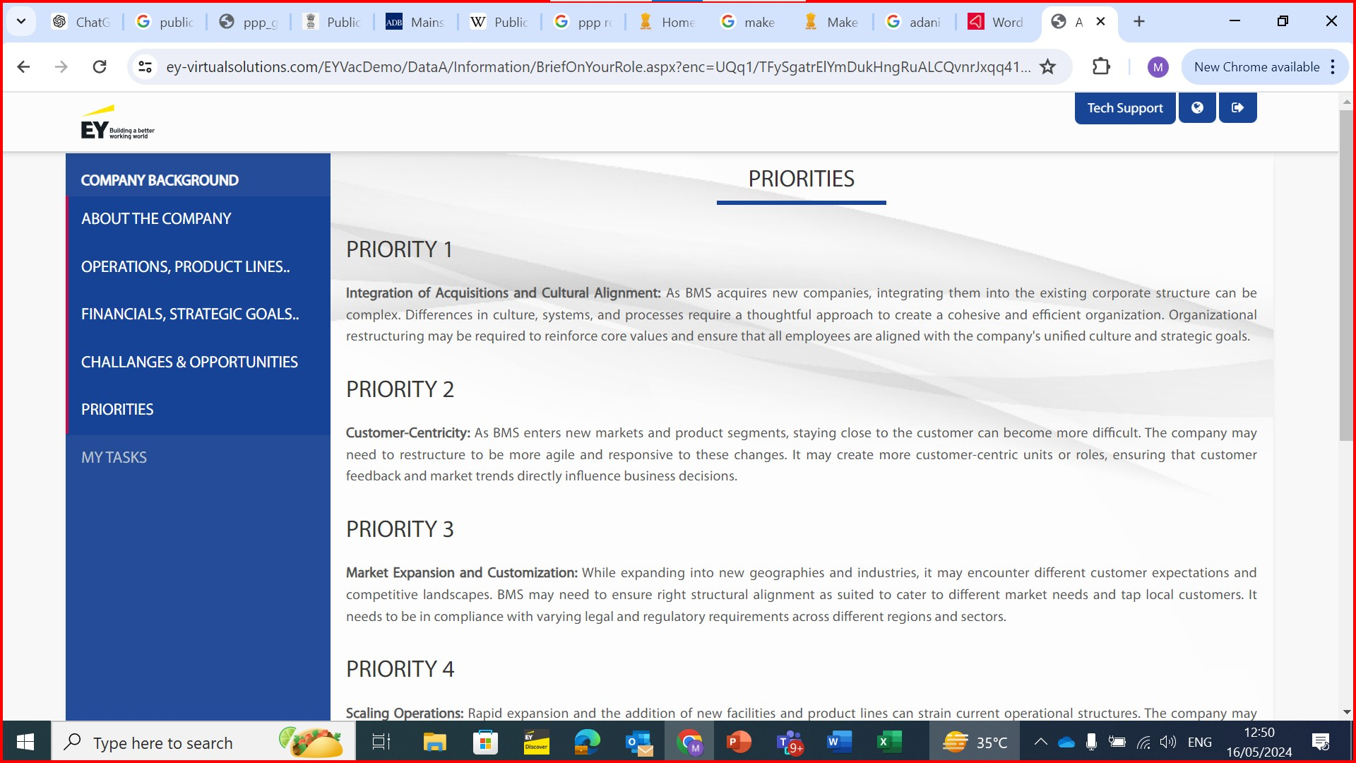
Tab Title – Organizational Priorities
Remove Priority 1,2,3 as sub headers

Slide 13
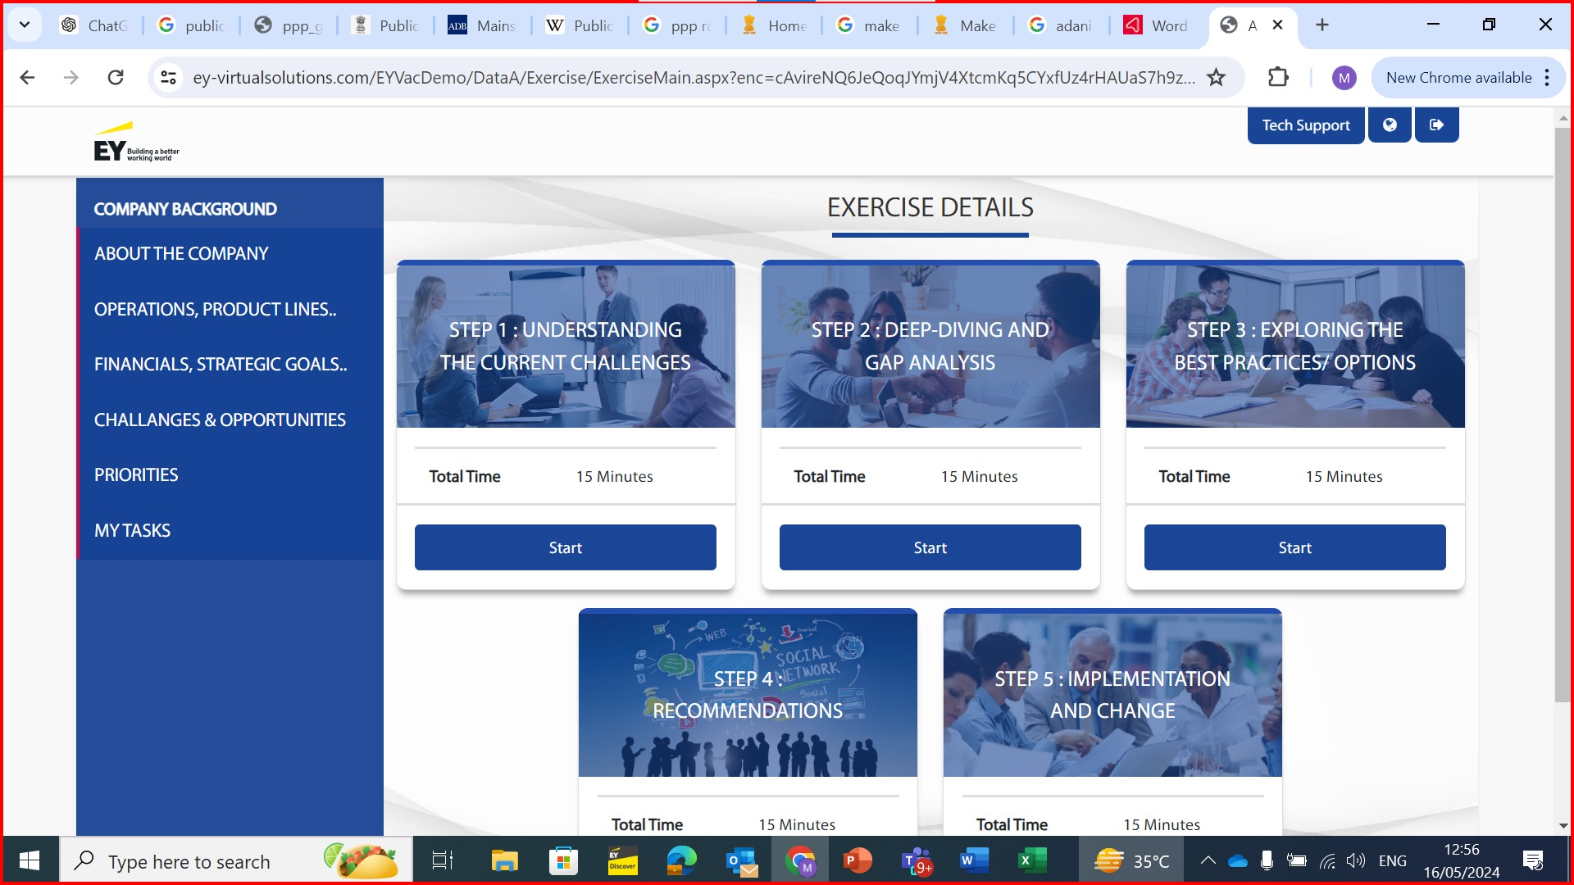
orange line on top of the boxes instead of blue

Slide 14
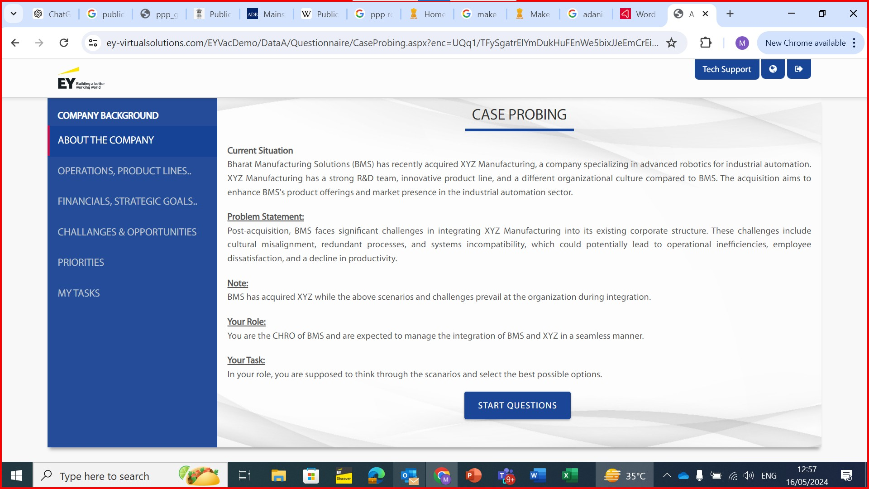
On entering the task, it should directly start with the questions

Slide 15
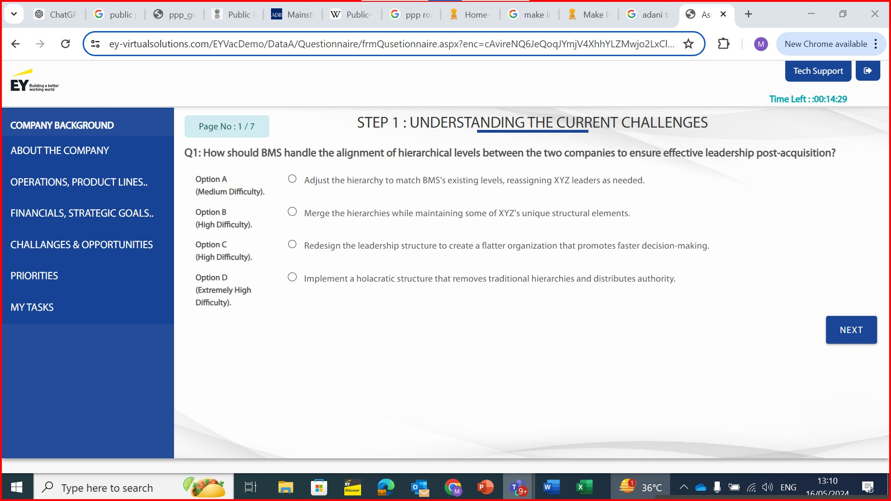
Slide background – the wavy lines are not visible. Keep it visible as shown in slide 16 sample
Remove Options A – D.
Only Statements should reflect with left alignment with the question – refer slide 17 placement
Font size of question and options to be same
start question 2 lines lower. Below question add the line – “Choose the option that indicates your response you are most likely to make in the situation”
Header – remove “step 1”. Keep “understanding the current challenges”
Timer – use timer style as shown in slide 18 sample. Add one space after colon before 00

Slide 16
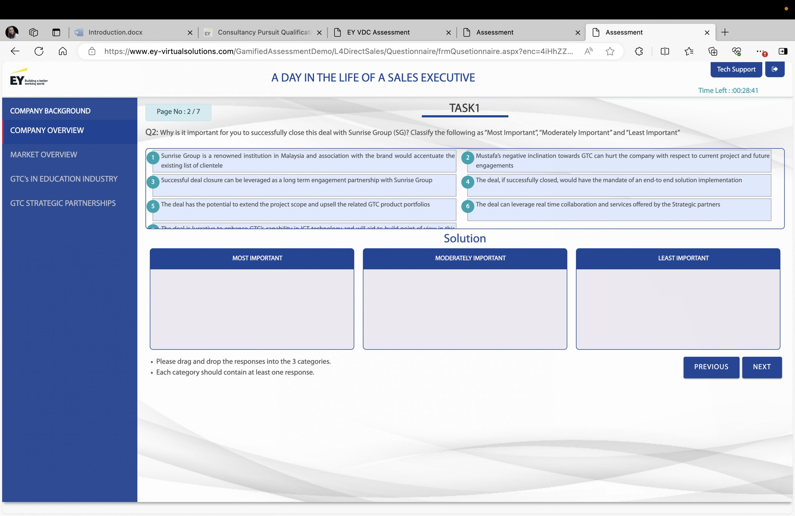

Slide 17
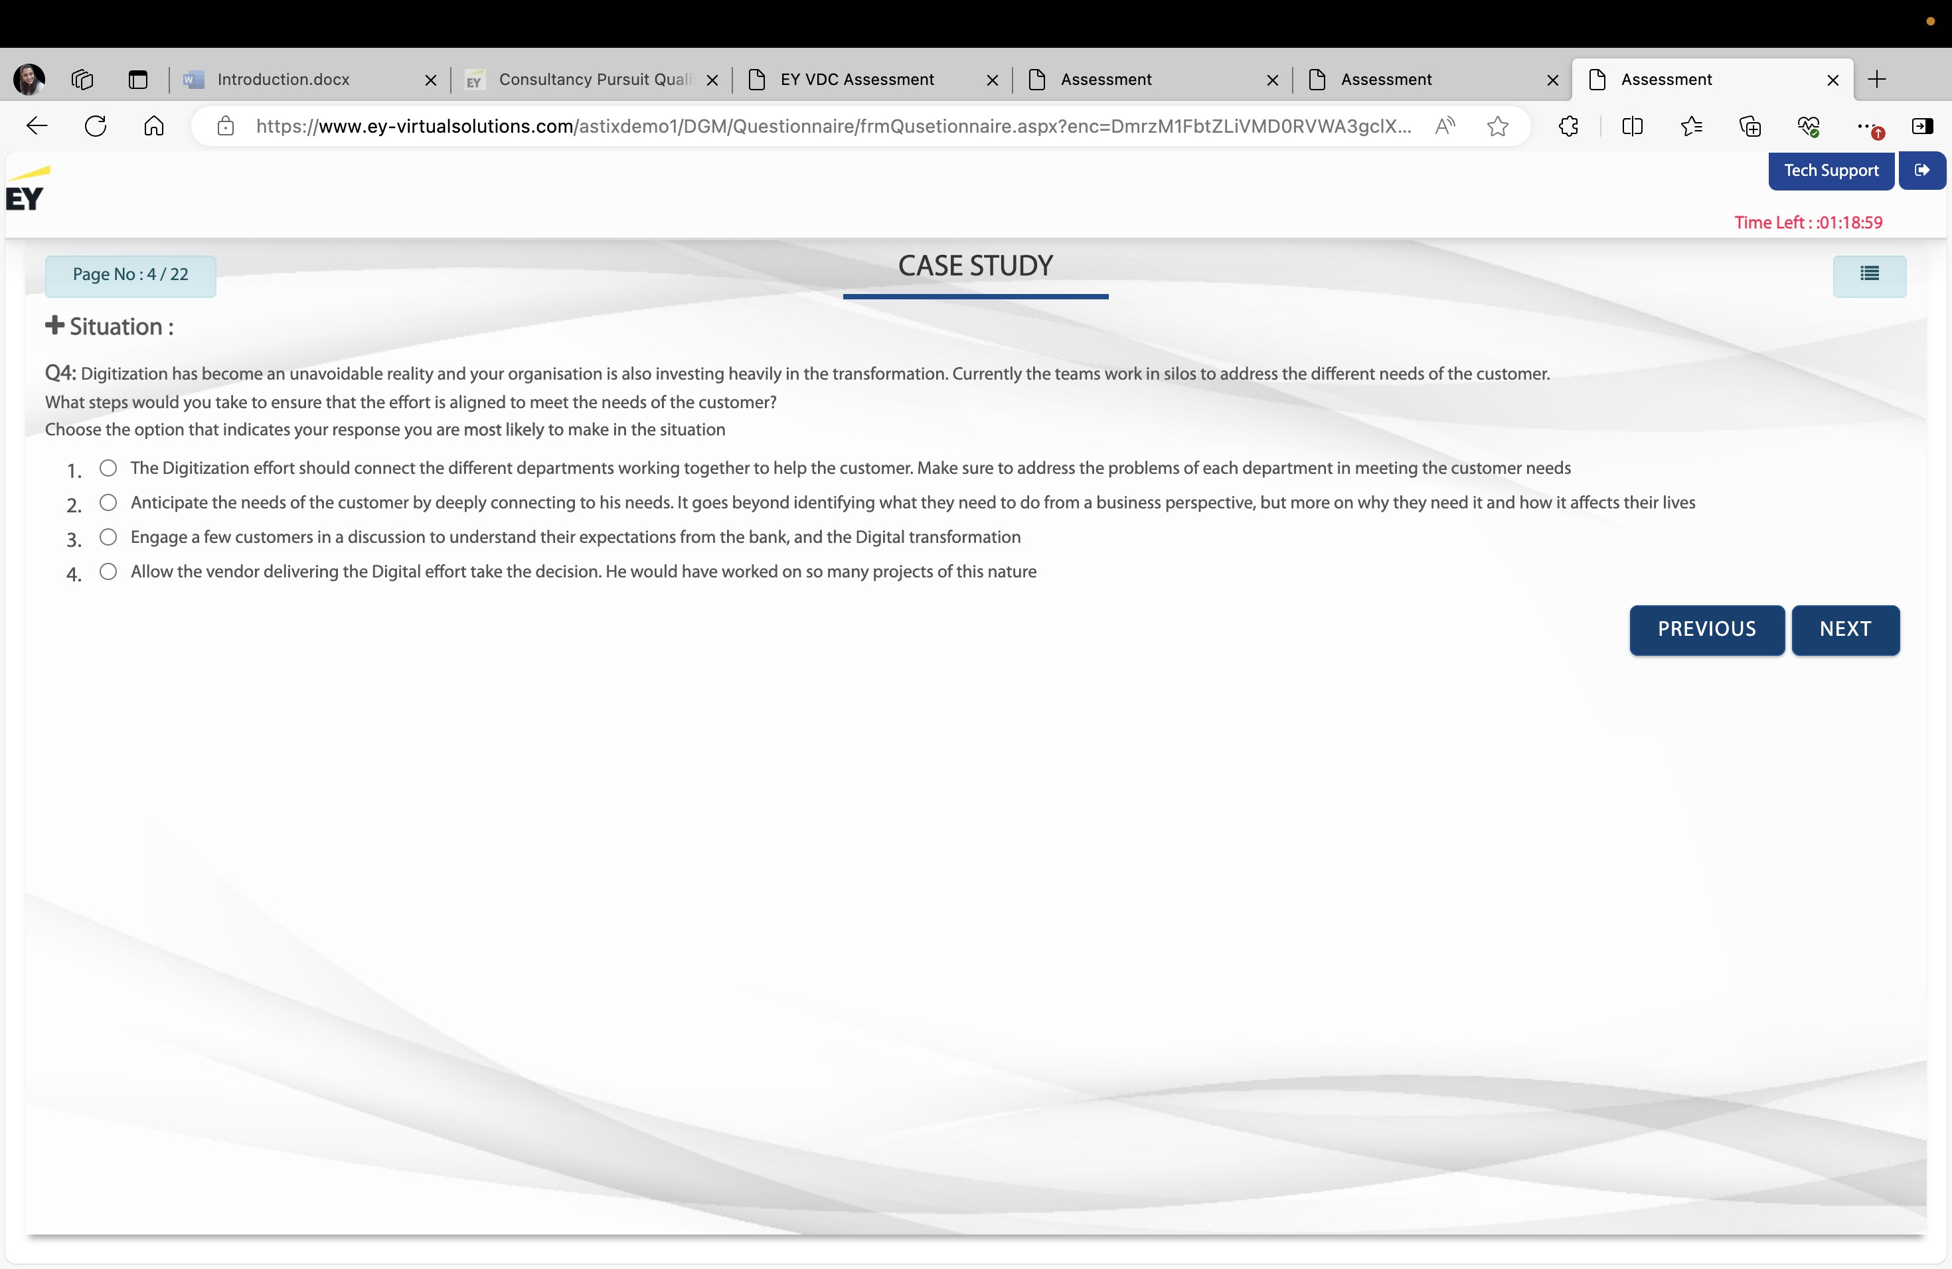

Slide 18
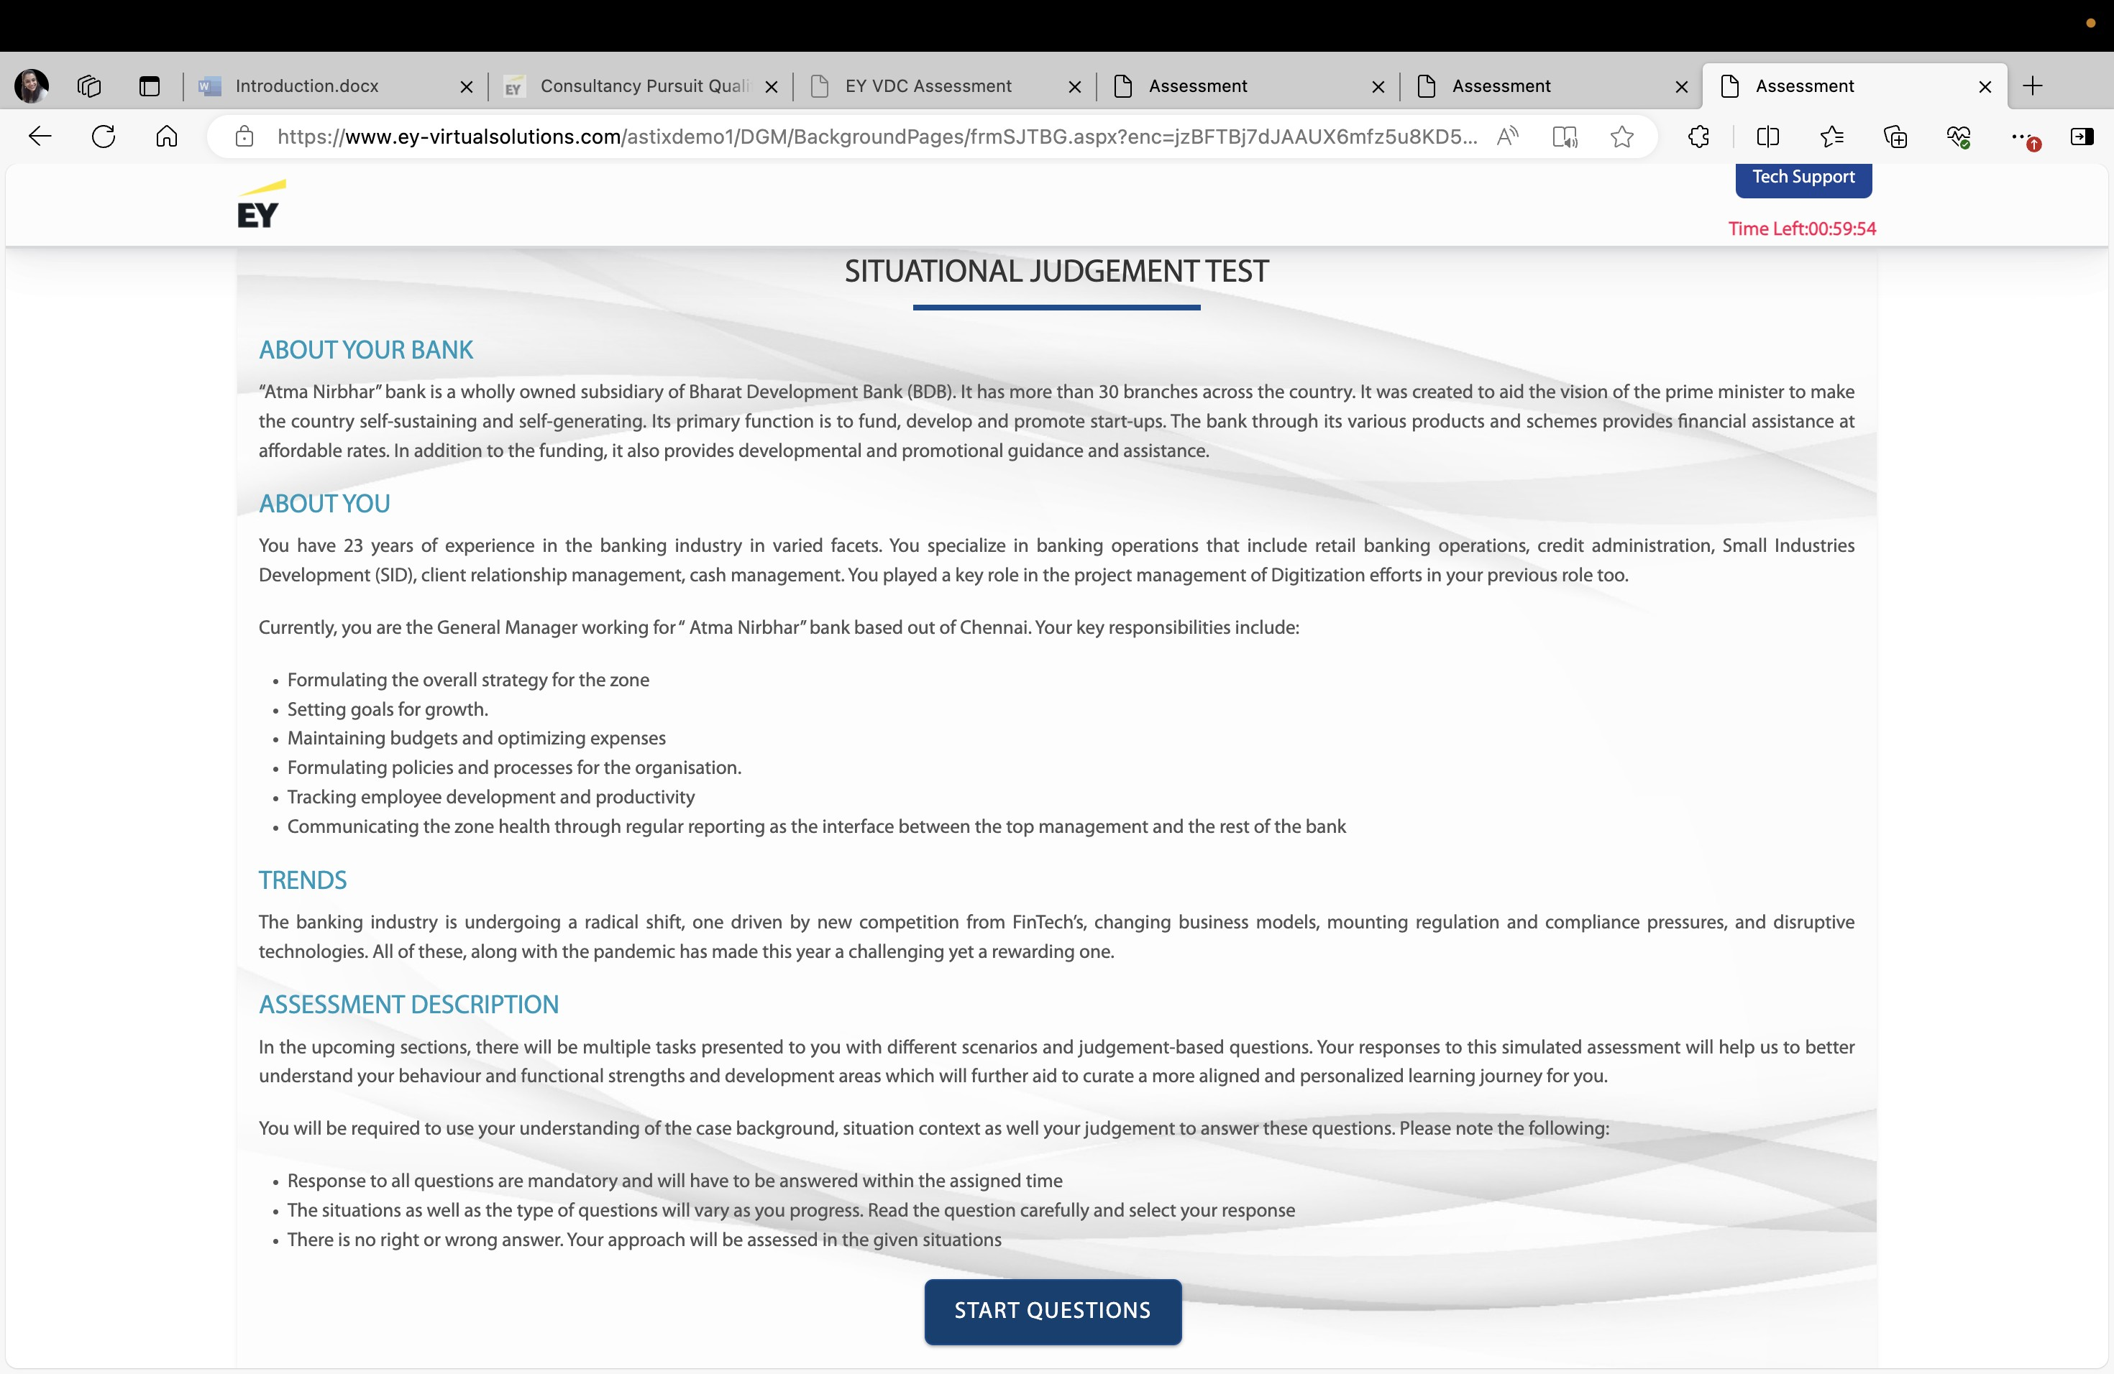
Overall colour scheme of entire site as below sample

Slide 19



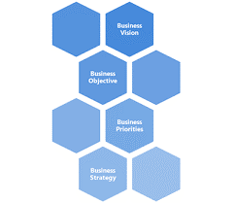


About the Company
Key Initiatives
Market Presence
Organizational Priorities
Growth Plans
Your Role & Current Context

Slide 20
Add feedback page after completion of the assessment process

